Slide 1
CLC Conference Death Reviews
Dr Elspeth McInnes AM
NCLC Conference Adelaide August 29-31

Slide 2
SA - A Right to Safety
Women’s Safety Strategy aims to reduce VAW
Regional approaches – VAW Collaborations & Family Safety Frameworks
Coroner's Office – research position within Coroner’s Court – also reports to Office for Women in the Attorney General’s Department and Chief Executive Group of department heads chaired by Minister – Gail Gago.

Slide 3
NEW DV Laws in SA
New Police Interim Intervention Orders in SA from December 2011. Intervention Orders [Prevention of Abuse] Act 2009.
Police had issued 1014 orders to the end of June.
1668 court actions against DV offenders between December -June 14, compared with 535 court issued orders for the same period the previous year under the old legislation.
(Advertiser July 22 2012)

Slide 4
OSCAR Statistics
Office for Crime Statistics and Research data shows that between July 2001 and June 2009 there were 45 domestic violence-related homicides in South Australia, of which 39 (87%) involved female victims and six male victims. (Advertiser July 22 2012).
Government focus to reduce DV is a significant positive achievement.

Slide 5
Recent known DV Deaths in SA
From July 08 to August 2012 SA has had 17 fatal events against a background of domestic violence
15 dead women + 2 dead children + 9 dead men + 1 stabbed woman + 1 stabbed baby = 24 dead people + 2 seriously injured in 3 years and 4 months.
All the 15 dead women and children and the two injured were killed or injured by men.
Seven of the dead men killed themselves, another was shot dead by Police and one died after being set alight by his wife after years of his domestic abuse of her.

Slide 6
SA Recent Frequency & Fatality Rates
2012 1 fatal event: 1 dead woman + 1 dead man
2011 3 fatal events: 3 dead women + 2 dead men
2010 = 2 fatal events. 2 dead women
2009 = 8 fatal events: 7 dead women + 3 dead men + 2 dead children = 12 dead people
July 08 to the end of 2008 = 3 fatal events; 2 dead women + 2 dead men = 4 dead people.

Slide 7
Community Activism for DV Death Review Process
Victim Support Services, WEAVE Inc., Women’s Legal Services, YWCA, academics, Office for Women, Domestic Violence Services SA Coalition, family members of victims pushed for DV Death Reviews.
Red Rose Rallies on Parliament House Steps when homicides occurred.
Remembrance Quilt Project, state & national
December 2009 DV Death Review Roundtable
2010 Forum by YWCA on DV Death Reviews.
National Domestic Violence Death Review Action Group formation 2010.

Slide 8
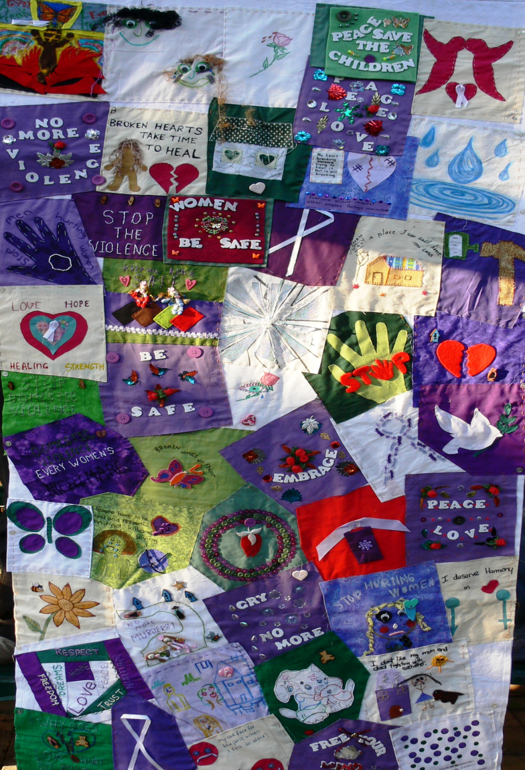
SA Remembrance Quilt

Slide 9
National Quilt

Slide 10
2010 DV Death Review Forum SA

Slide 11
SA Coroner's Office 2010-11 Annual Report
2010 SA Government committed to employ a research officer in the Coroner’s Office, in partnership with the Office for Women, to investigate domestic violence related deaths.
4 year appointment commenced January 2011
Can investigate open and closed cases involving single homicide, single suicide or multiple deaths.

Slide 12
Scope of DV Research position Annual Report 2010-11 p.7
‘Identify DV Contexts, issues and service systems to investigate adequacy of system responses.
Identify systemic issues or inter-agency approaches to assist in death prevention in DV contexts
Provide advice to build the capacity of the Coronial Inquest to explore & inquire into system responses to DV and recommend improvements with preventative focus.
Develop data collection systems to enable provision of advice to coronial processes and enable identification of demographic or service trends, gaps or improvements.’

Slide 13
National Network
National Family Domestic Violence Death Review Network established in April 2011 with NSW, Victoria, Queensland and SA.
Coronial jurisdictions share information, align investigation processes and collaborate on best practice.
WA has formed a DV death review process in the Ombudsman’s Office.

Slide 14
DV Death Review Activity in SA
Continuous process of development over time.
2 inquests so far where DV was a feature of the deaths.
Deputy State Coroner issued preliminary finding & recommendation that Family Safety Framework process be implemented in Murray-Mallee Police region.
Arose as an outcome of evidence and advice on the potential benefit of inter-agency collaboration in management of high risk DV matters (p8).

Slide 15
Death Review Recommendations re Firearms
Amend Bail Act 1985 for specific domestic violence offences, timing of court appearance and firearms test & align with the new Intervention Orders Act 2009.
SAPOL – attention to improving evidence and statement collection and investigation of access to firearms and better access to intelligence re repeat offenders.
SAPOL & DV sector to improve surveillance and communication re breaches of bail, access to firearms and offending history.

Slide 16
FAMILY SAFETY FRAMEWORK
SA government announced a state-wide roll-out of FSF in June this year following Coronial recommendations.
Common risk assessment process across agencies.
The Family Safety Meetings are chaired by SA Police and attended by representatives from local agencies.
These agencies include Families SA, Housing SA, Community Corrections, Health Services, Adult Mental Health Services, Drug and Alcohol Services, Education, Women's Domestic Violence Services and Victim Support Service.

Slide 17
FSF Strengths
Educates agencies in DV contexts and system processes.
Common risk assessment avoids different agencies from assessing risk at different levels.
Information sharing between agencies about features of the case and the people involved.
Co-ordinated efforts of relevant agencies working with the victim/s.

Slide 18
FSF Critique
Focus on victim/s not perpetrator.
Does not curtail perpetrator behaviour.
Victim/s can be seen as responsible for the violence against them if they are not seen as ‘co-operative’.
Can reduce victim’s agency and can discount their knowledge about their circumstance.
A matter of time before a FSF identified victim is killed as it does not control the perpetrator.

Slide 19
Strengths of SA DV Death Review Approach
Positive initiative to have a DV death review process. Much better than not having anything.
Able to scrutinise policies, departments, agencies, frameworks and processes for gaps, flaws, failures & report on open cases.
Able to liaise with and share information with other jurisdictions.
Coroner’s office already geared to investigate deaths.

Slide 20
Limits of SA DV Death Review Approach
Is a research position rather than a panel or board.
Is not legislated so vulnerable to de-funding.
Is within the coronial process rather than the wider community – thus potentially constrained by being within a government agency.
Is not, so far, readily open to public scrutiny beyond individual coronial reports.
No legislative requirement for government response to coronial recommendations.
Federal-state divide (universal problem)

